Slide 1
Conditional Probability
slides are based on lecture notes on Probability Theory by Phanuel Mariano

Slide 2
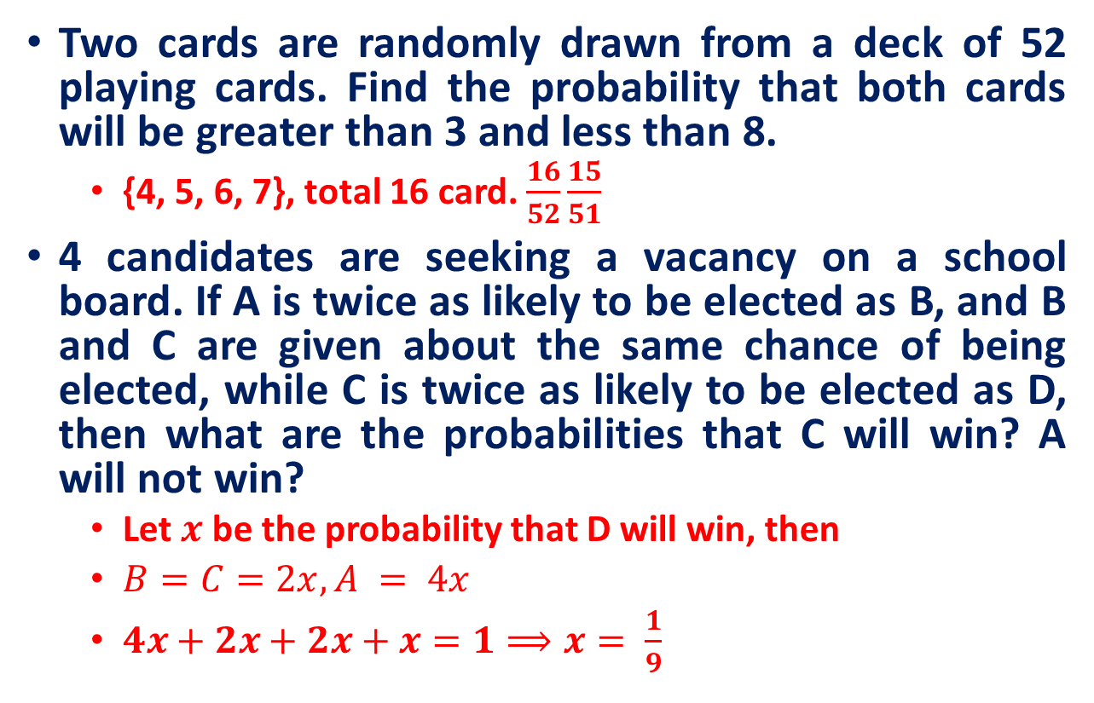
Practice Exercises
Two cards are randomly drawn from a deck of 52 playing cards. Find the probability that both cards will be greater than 3 and less than 8.
{4, 5, 6, 7}, total 16 card. $\frac{16}{52}\frac{15}{51}$
4 candidates are seeking a vacancy on a school board. If A is twice as likely to be elected as B, and B and C are given about the same chance of being elected, while C is twice as likely to be elected as D, then what are the probabilities that C will win? A will not win?
Let $x$ be the probability that D will win, then
$B=C=2x, A = 4x$
$4x+2x+2x+x=1⟹x= \frac{1}{9}$

Slide 3
Recall
Sample Space
The set of all possible outcomes for an experiment is the sample space.
Tossing a coin: {H, T}
Tossing two coin: {HH,HT, TH, TT}
Event
Consists of one or more outcomes and is a subset of the sample space.
A die is tossed. Event A is observing an even number.
A = {2, 4, 6}
An event that consists of a single outcome is called simple event

Slide 4
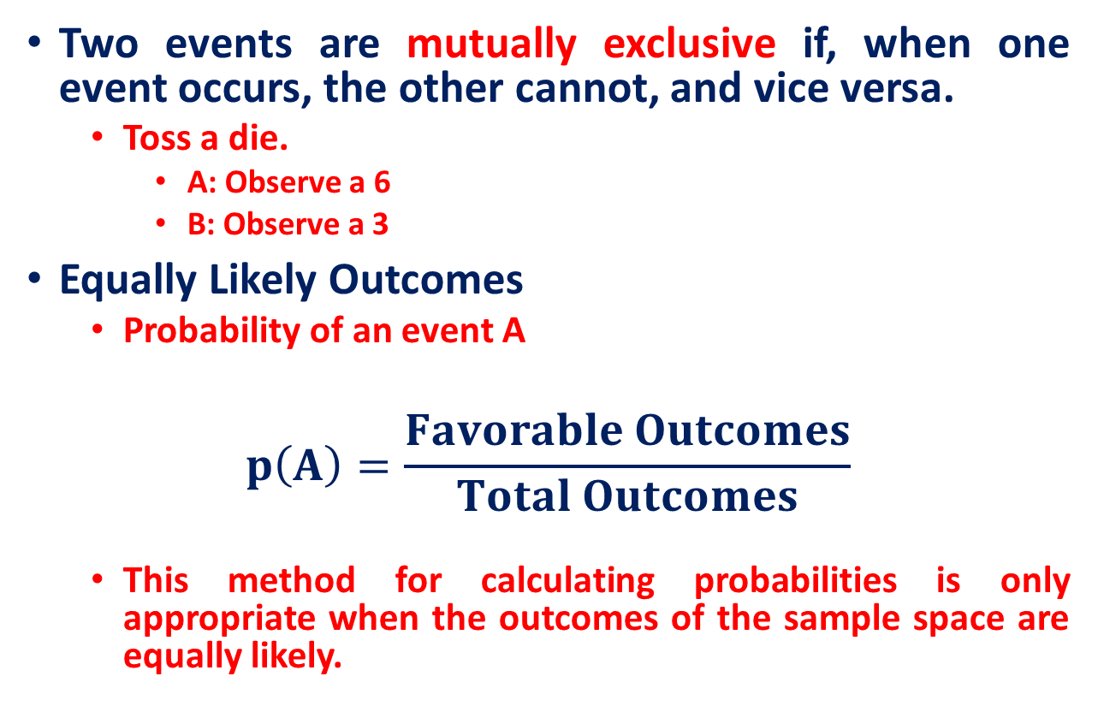
Recall
Two events are mutually exclusive if, when one event occurs, the other cannot, and vice versa.
Toss a die.
A: Observe a 6
B: Observe a 3
Equally Likely Outcomes
Probability of an event A
$$p\left(A\right)=\frac{Favorable Outcomes}{Total Outcomes}$$
This method for calculating probabilities is only appropriate when the outcomes of the sample space are equally likely.

Slide 5
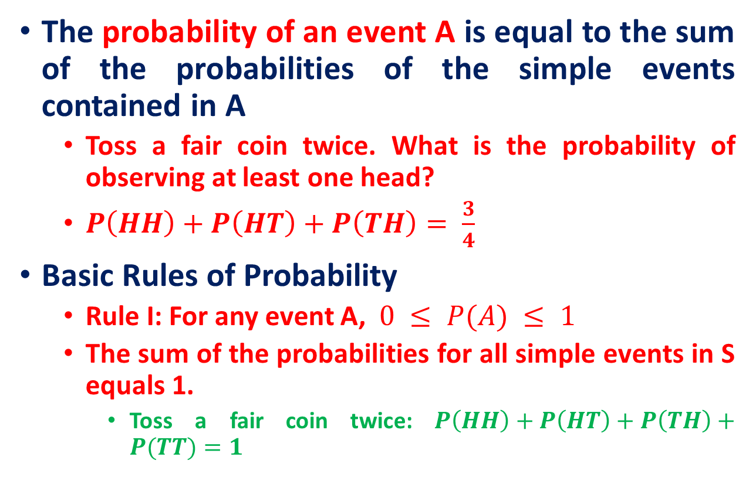
Recall
The probability of an event A is equal to the sum of the probabilities of the simple events contained in A
Toss a fair coin twice. What is the probability of observing at least one head?
$P\left(HH\right)+P\left(HT\right)+P\left(TH\right)= \frac{3}{4}$
Basic Rules of Probability
Rule I: For any event A, $0 ≤ P(A) ≤ 1$
The sum of the probabilities for all simple events in S equals 1.
Toss a fair coin twice: $P\left(HH\right)+P\left(HT\right)+P\left(TH\right)+P(TT)=1$

Slide 6
Recall
Counting Principle
Sample space of throwing 3 dice has 216 entries, sample space of throwing 4 dice has 1296 entries, …
We need a way to help us count faster rather than counting by hand one by one.
(Basic Counting Principle) Suppose 2 experiments are to be performed.
If one experiment can result in m possibilities
Second experiment can result in n possibilities
Then together there are mn possibilities

Slide 7

Recall
A college planning committee consists of 3 freshmen, 4 second year’s, 5 juniors, and 2 seniors. A subcommittee of 4 consists 1 person from each class. How many such subcommittee?
$3×4×5×2=120$
(Basic Counting Principle) Suppose 2 experiments are to be performed.
If one experiment can result in m possibilities
Second experiment can result in n possibilities
Then together there are mn possibilities

Slide 8
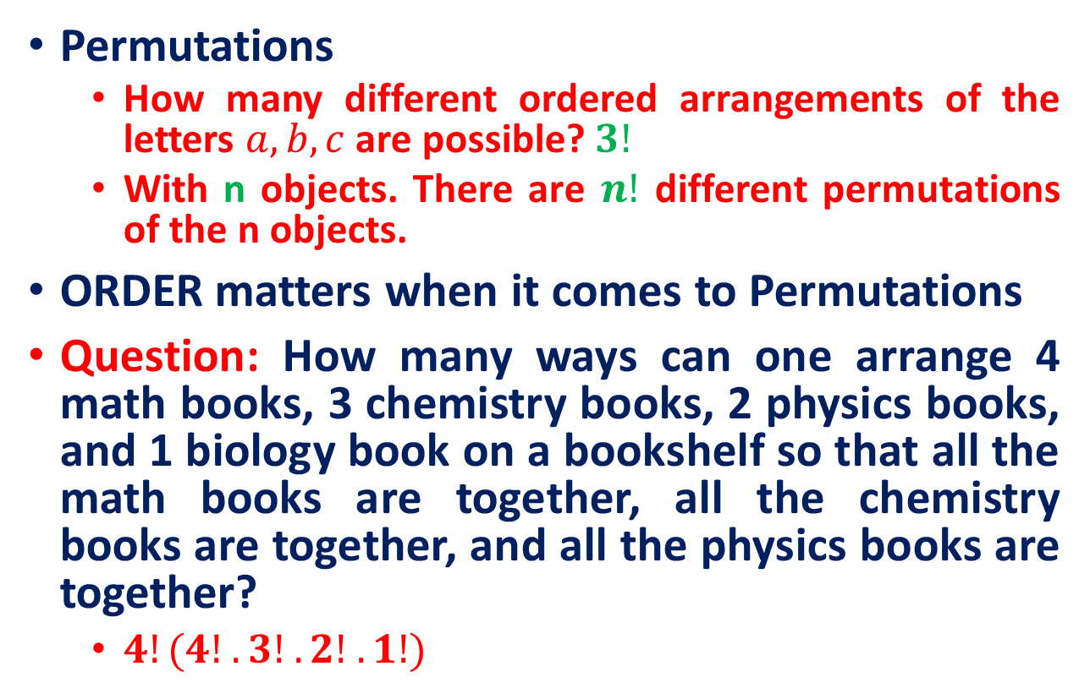
Recall
Permutations
How many different ordered arrangements of the letters $a, b, c$are possible? $3!$
With n objects. There are $n!$ different permutations of the n objects.
ORDER matters when it comes to Permutations
Question: How many ways can one arrange 4 math books, 3 chemistry books, 2 physics books, and 1 biology book on a bookshelf so that all the math books are together, all the chemistry books are together, and all the physics books are together?
$4!(4! . 3! . 2! .1!)$

Slide 9
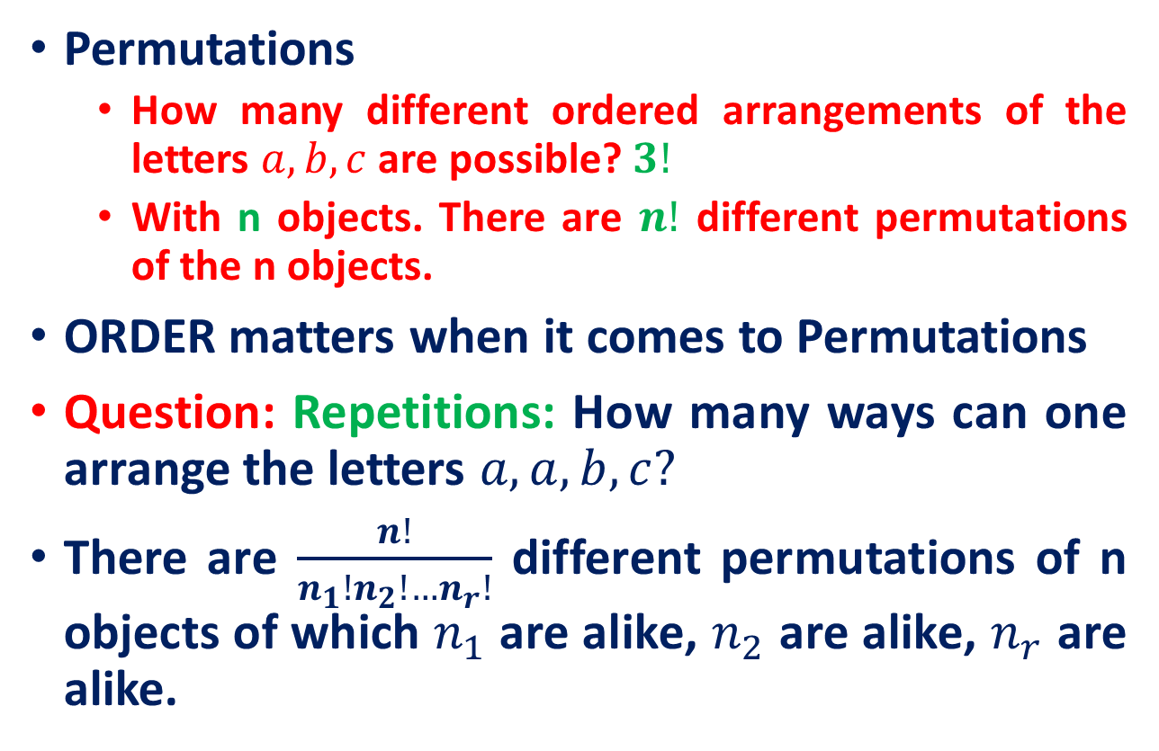
Recall
Permutations
How many different ordered arrangements of the letters $a, b, c$are possible? $3!$
With n objects. There are $n!$ different permutations of the n objects.
ORDER matters when it comes to Permutations
Question: Repetitions: How many ways can one arrange the letters $a,a, b, c?$
There are $\frac{n!}{n_{1}!n_{2}!…n_{r}!}$ different permutations of n objects of which $n_{1}$ are alike, $n_{2}$ are alike, $n_{r}$ are alike.

Slide 10
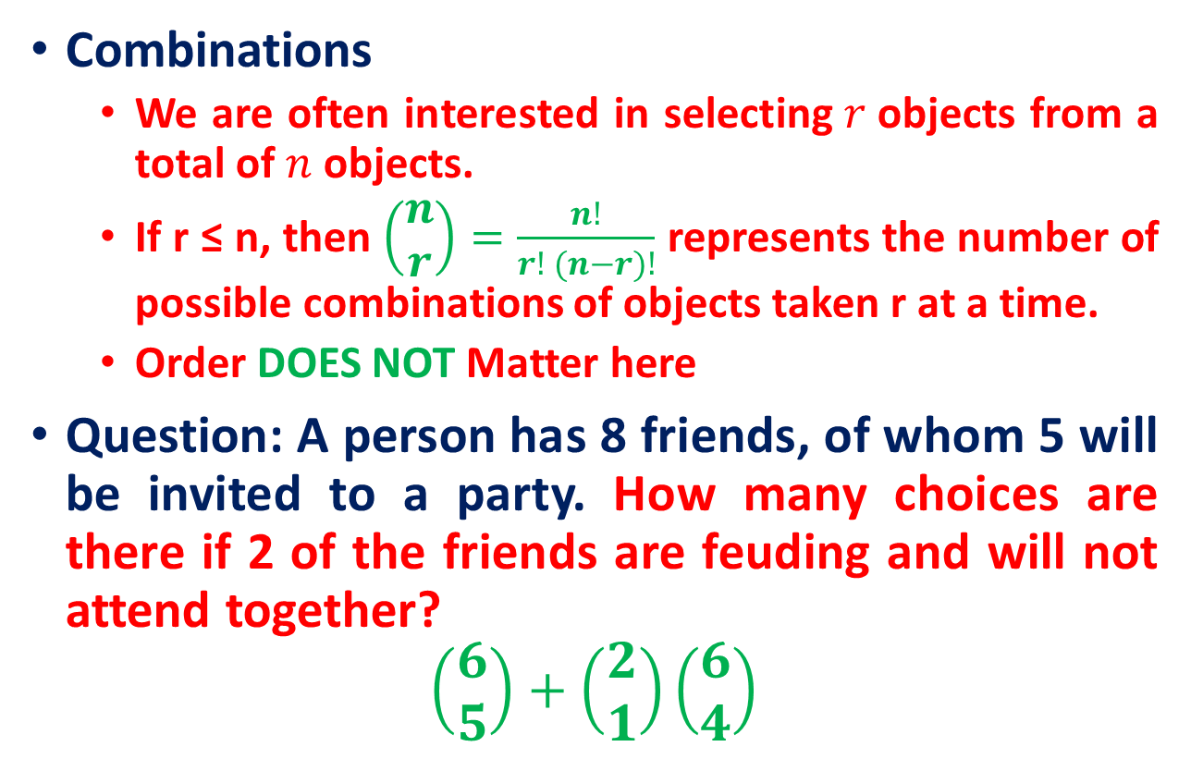
Recall
Combinations
We are often interested in selecting$r$objects from a total of $n$ objects.
If r ≤ n, then $\left(\begin{matrix}n \\ r\end{matrix}\right)=\frac{n!}{r! (n−r)!}$ represents the number of possible combinations of objects taken r at a time.
Order DOES NOT Matter here
Question: A person has 8 friends, of whom 5 will be invited to a party. How many choices are there if 2 of the friends are feuding and will not attend together?
$$\left(\begin{matrix}6 \\ 5\end{matrix}\right)+\left(\begin{matrix}2 \\ 1\end{matrix}\right)\left(\begin{matrix}6 \\ 4\end{matrix}\right)$$

Slide 11
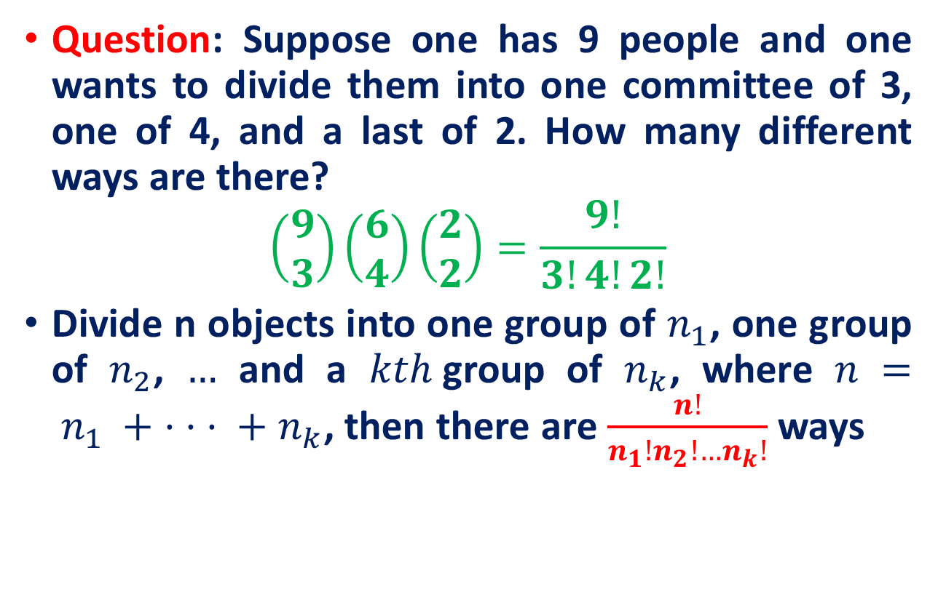
Recall
Question: Suppose one has 9 people and one wants to divide them into one committee of 3, one of 4, and a last of 2. How many different ways are there?
$$\left(\begin{matrix}9 \\ 3\end{matrix}\right)\left(\begin{matrix}6 \\ 4\end{matrix}\right)\left(\begin{matrix}2 \\ 2\end{matrix}\right)=\frac{9!}{3!4!2!}$$
Divide n objects into one group of $n_{1}$, one group of $n_{2}$, $…$ and a $kth$group of $n_{k}$, where $n = n_{1} + · · · + n_{k}$, then there are $\frac{n!}{n_{1}!n_{2}!…n_{k}!}$ ways

Slide 12
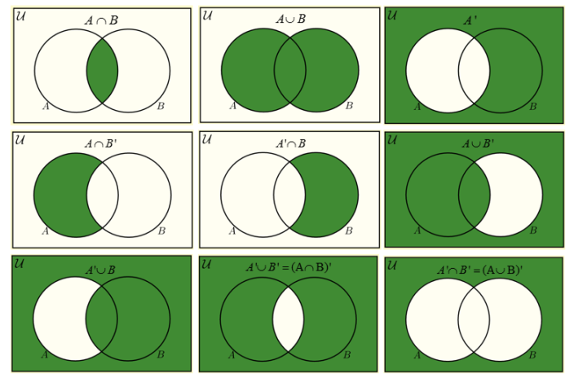
Recall

Slide 13
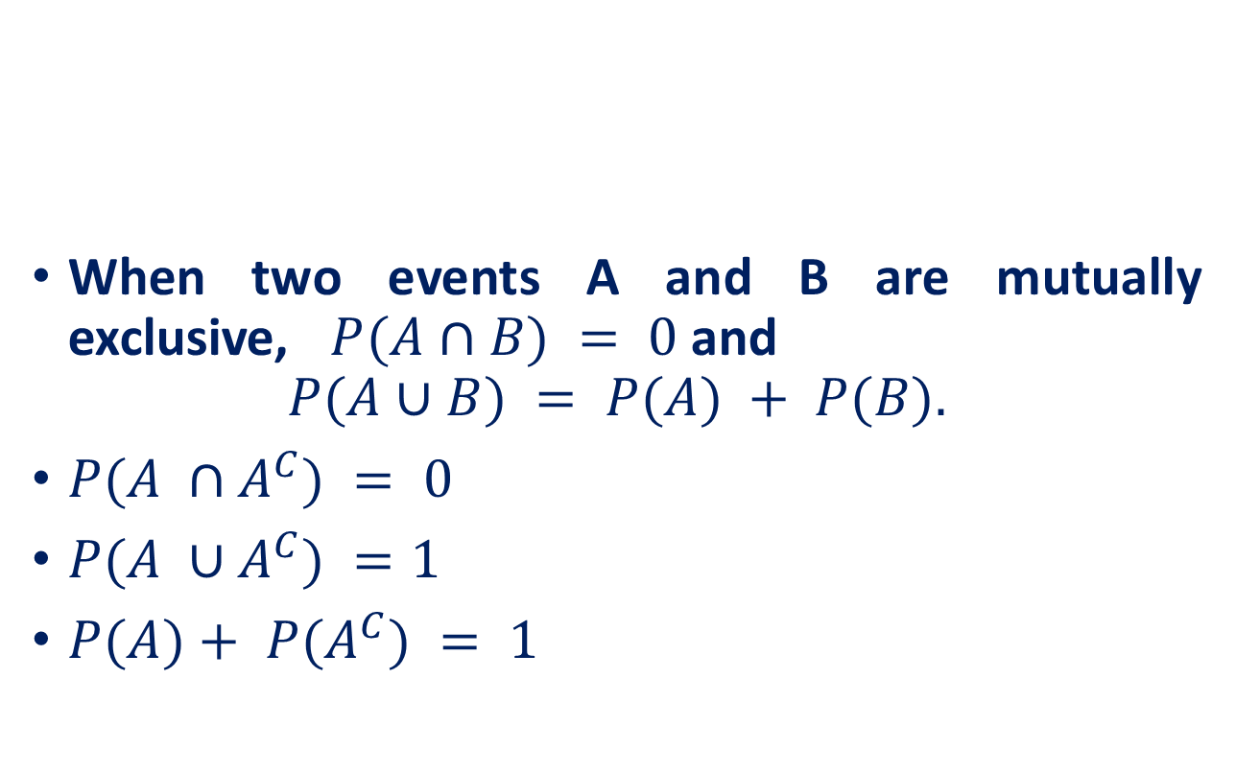
Recall
When two events A and B are mutually exclusive, $P(A∩B) = 0$and
$$P(A∪B) = P(A) + P(B).$$
$P(A ∩A^{C}) = 0$
$P(A ∪A^{C}) =1$
$P(A)+ P(A^{C}) = 1$
A
B
A^{C}
A

Slide 14
Will You Play?
Suppose that a “friend” offers you to play a game. He has three cards, one red on both sides, one black on both sides, and one red on one side and black on the other.
He mixes the three cards in a hat, picks one at random, and places it flat on the table with only one side showing.
Suppose that one side is red. He then offers to bet his $4 against your $3 that the other side of the card is also red.

Slide 15
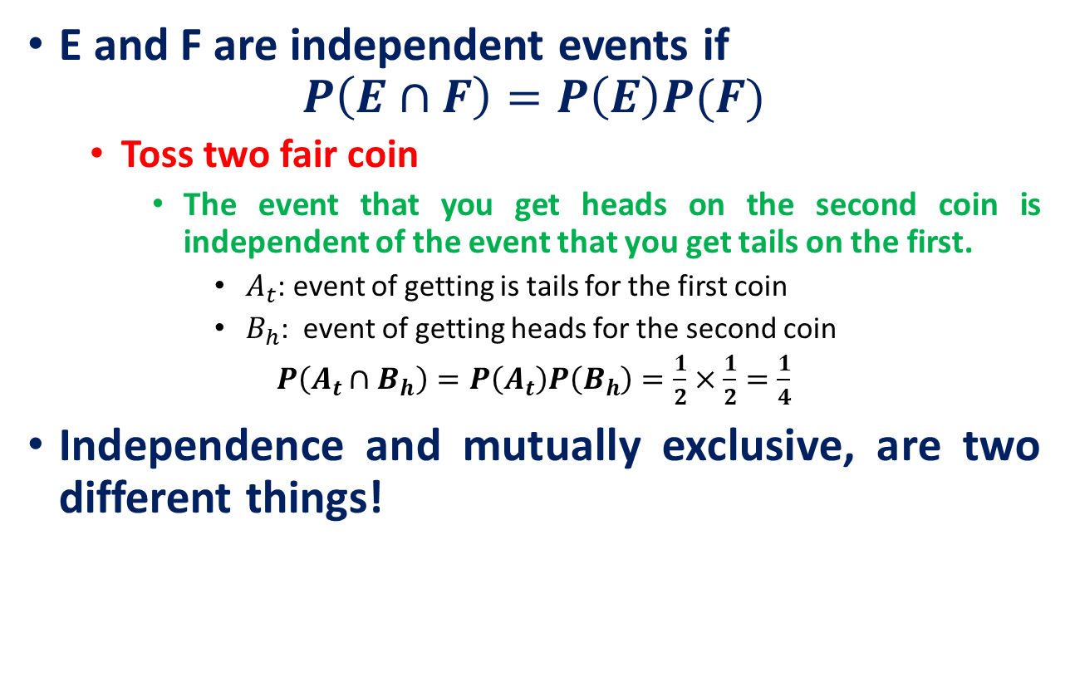
Independent Events
E and F are independent events if
$$P\left(E∩F\right)=P\left(E\right)P(F)$$
Toss two fair coin
The event that you get heads on the second coin is independent of the event that you get tails on the first.
$A_{t}$: event of getting is tails for the first coin
$B_{h}$: event of getting heads for the second coin
$P\left(A_{t}∩B_{h}\right)=P\left(A_{t}\right)P\left(B_{h}\right)=\frac{1}{2}×\frac{1}{2}=\frac{1}{4}$
Independence and mutually exclusive, are two different things!

Slide 16
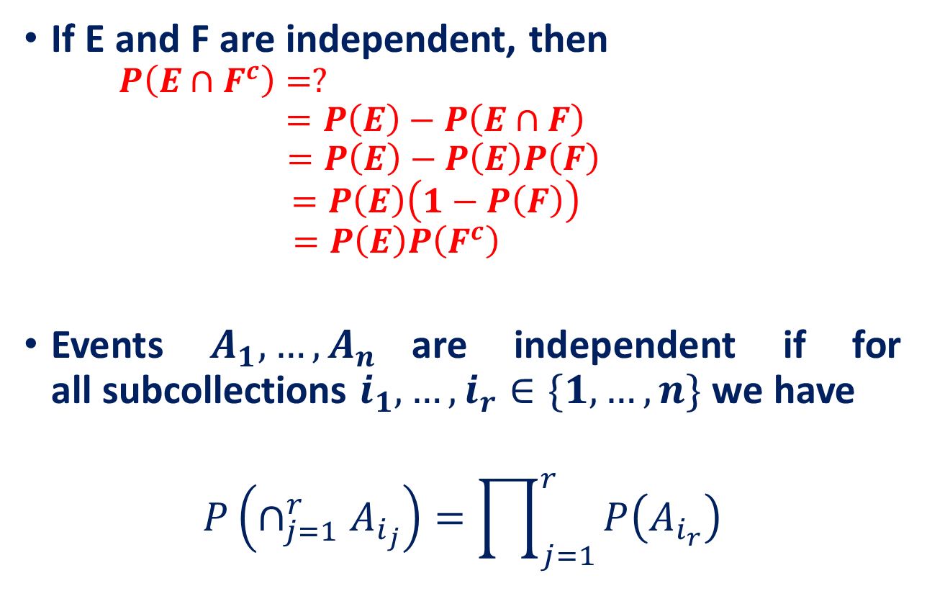
Independent Events
If E and F are independent, then
$$P\left(E∩F^{c}\right)=?$$
$$=P\left(E\right)−P\left(E∩F\right)$$
$$=P\left(E\right)−P\left(E\right)P\left(F\right)$$
$$=P\left(E\right)\left(1−P\left(F\right)\right)$$
$$=P\left(E\right)P\left(F^{c}\right)$$
Events $A_{1},…,A_{n}$are independent if for all subcollections $i_{1},…,i_{r}∈\{1, …,n\}$ we have
$$P\left(∩_{j=1}^{r}A_{i_{j}}\right)=\prod_{j=1}^{r}{P\left(A_{i_{r}}\right)}$$

Slide 17
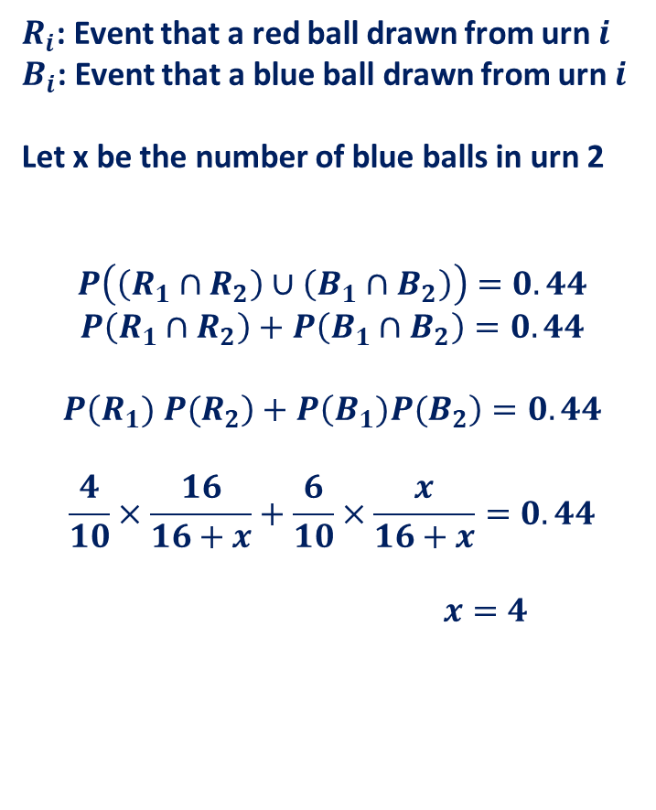
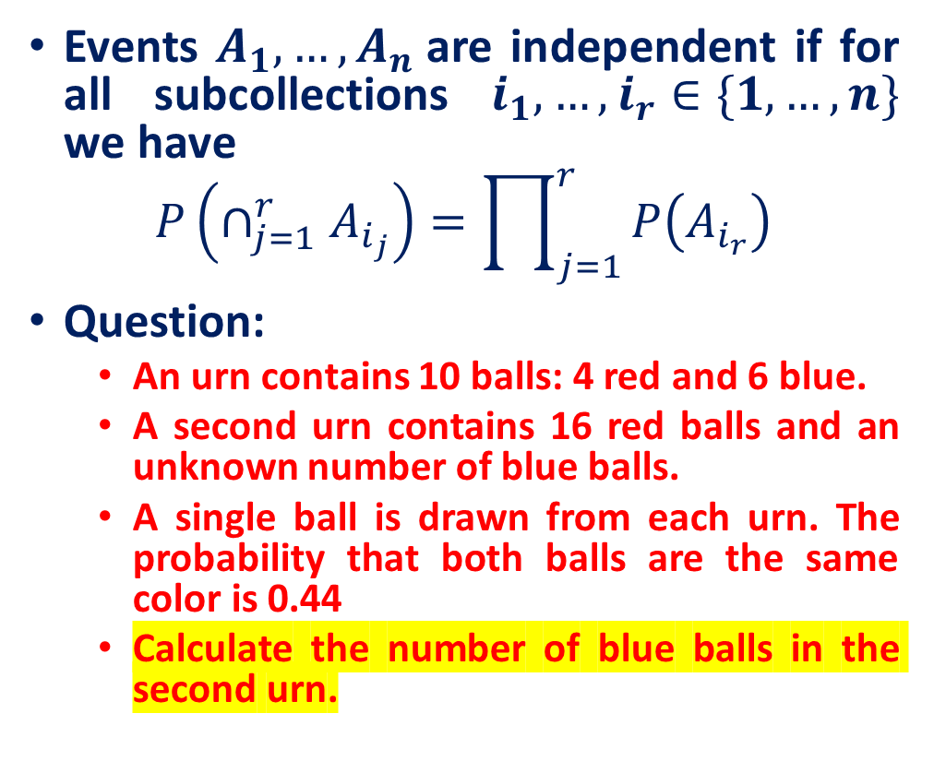
Independent Events
Events $A_{1},…,A_{n}$are independent if for all subcollections $i_{1},…,i_{r}∈\{1, …,n\}$ we have
$$P\left(∩_{j=1}^{r}A_{i_{j}}\right)=\prod_{j=1}^{r}{P\left(A_{i_{r}}\right)}$$
Question:
An urn contains 10 balls: 4 red and 6 blue.
A second urn contains 16 red balls and an unknown number of blue balls.
A single ball is drawn from each urn. The probability that both balls are the same color is 0.44
Calculate the number of blue balls in the second urn.
$R_{i}$: Event that a red ball drawn from urn $i$
$B_{i}$: Event that a blue ball drawn from urn $i$
Let x be the number of blue balls in urn 2
$$P\left(\left(R_{1}∩R_{2}\right)∪\left(B_{1}∩B_{2}\right)\right)=0.44$$
$$P\left(R_{1}∩R_{2}\right)+P\left(B_{1}∩B_{2}\right)=0.44$$
$$P\left(R_{1}) P(R_{2}\right)+P\left(B_{1})P(B_{2}\right)=0.44$$
$$\frac{4}{10}×\frac{16}{16+x}+\frac{6}{10}×\frac{x}{16+x}=0.44$$
$$x=4$$

Slide 18
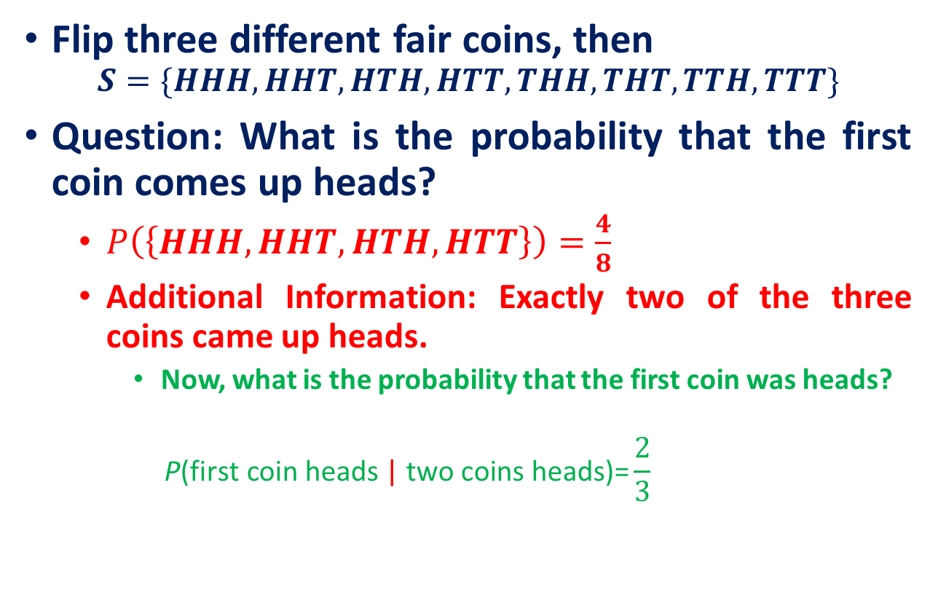
Conditional Probability and Independence
Flip three different fair coins, then
$$S=\{HHH, HHT, HTH, HTT, THH, THT, TTH, TTT\}$$
Question: What is the probability that the first coin comes up heads?
$P\left(\left\{HHH, HHT, HTH, HTT\right\}\right)=\frac{4}{8}$
Additional Information: Exactly two of the three coins came up heads.
Now, what is the probability that the first coin was heads?
$$\text{P}\text{(}\text{first} \text{coin} \text{heads}\text{ | }\text{two} \text{coins} \text{heads}\text{)=}\frac{2}{3}$$
“conditional on,” or “given that
More precisely, we have computed a conditional probability. That is, we have determined that, conditional on knowing that exactly two coins came up heads, the conditional probability of the first coin being head is 2/3.

Slide 19
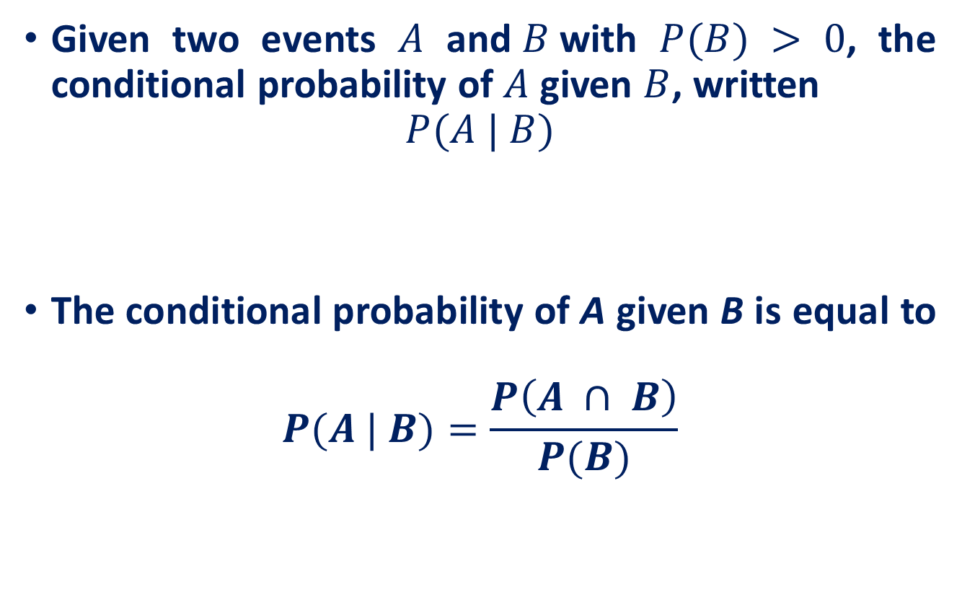
Conditional Probability
Given two events $A$ and$B$with $P(B) > 0$, the conditional probability of $A$ given $B$, written
$$P(A | B)$$
The conditional probability of A given B is equal to
$$P(A | B)=\frac{P\left(A ∩ B\right)}{P(B)}$$
Fraction of the time that A occurs once we know that B occurs.

Slide 20
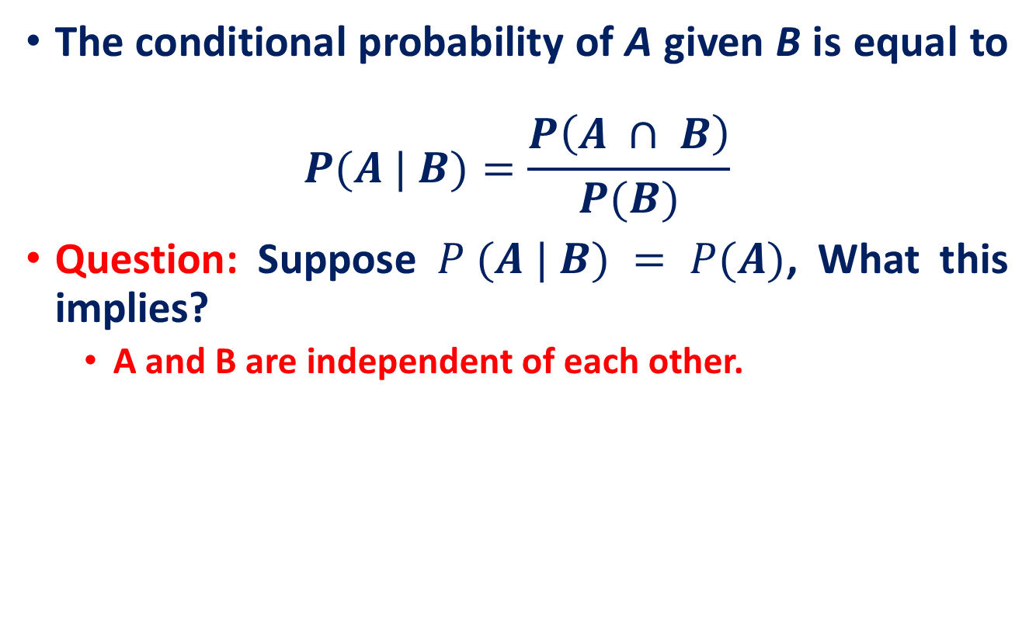
Conditional Probability
The conditional probability of A given B is equal to
$$P(A | B)=\frac{P\left(A ∩ B\right)}{P(B)}$$
Question: Suppose $P (A | B) = P(A)$, What this implies?
A and B are independent of each other.

Slide 21
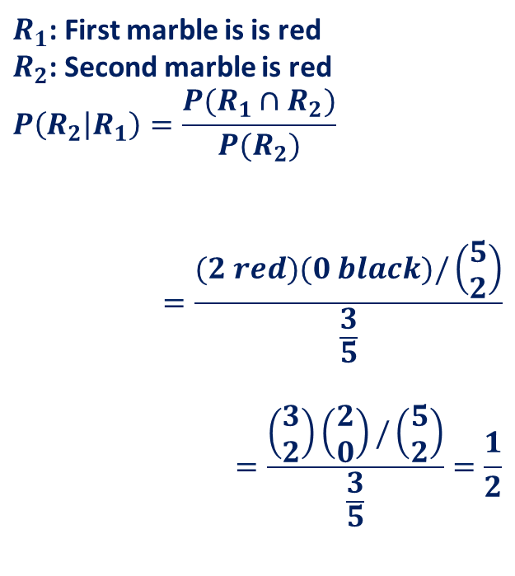
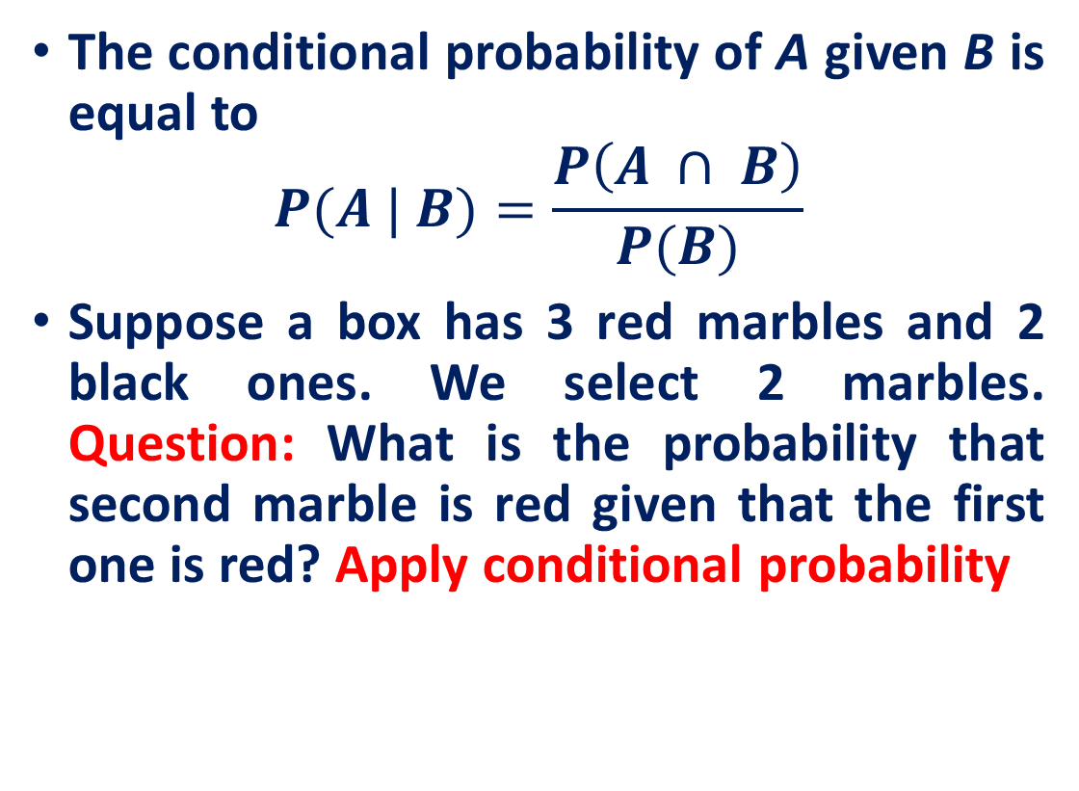
Conditional Probability
The conditional probability of A given B is equal to
$$P(A | B)=\frac{P\left(A ∩ B\right)}{P(B)}$$
Suppose a box has 3 red marbles and 2 black ones. We select 2 marbles. Question: What is the probability that second marble is red given that the first one is red? Apply conditional probability
$R_{1}$: First marble is is red
$R_{2}$: Second marble is red
$$P\left(R_{2} | R_{1}\right)=\frac{P(R_{1}∩R_{2})}{P(R_{2})}$$
$$=\frac{(2 red)(0 black)/\left(\begin{matrix}5 \\ 2\end{matrix}\right)}{\frac{3}{5}}$$
$$=\frac{\left(\begin{matrix}3 \\ 2\end{matrix}\right)\left(\begin{matrix}2 \\ 0\end{matrix}\right)/\left(\begin{matrix}5 \\ 2\end{matrix}\right)}{\frac{3}{5}}=\frac{1}{2}$$

Slide 22
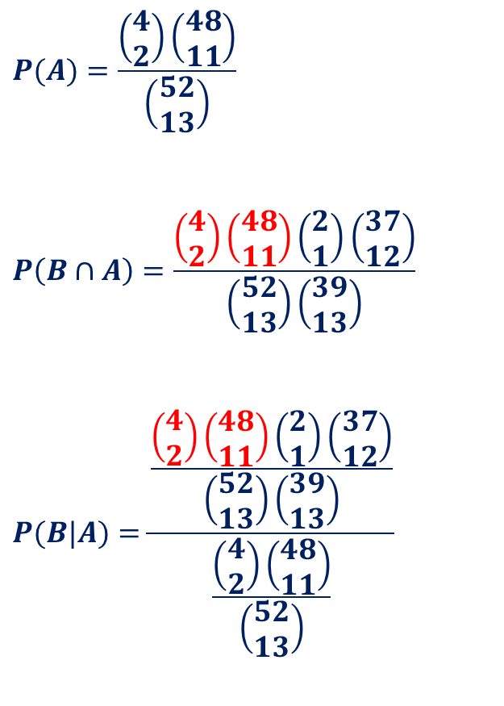
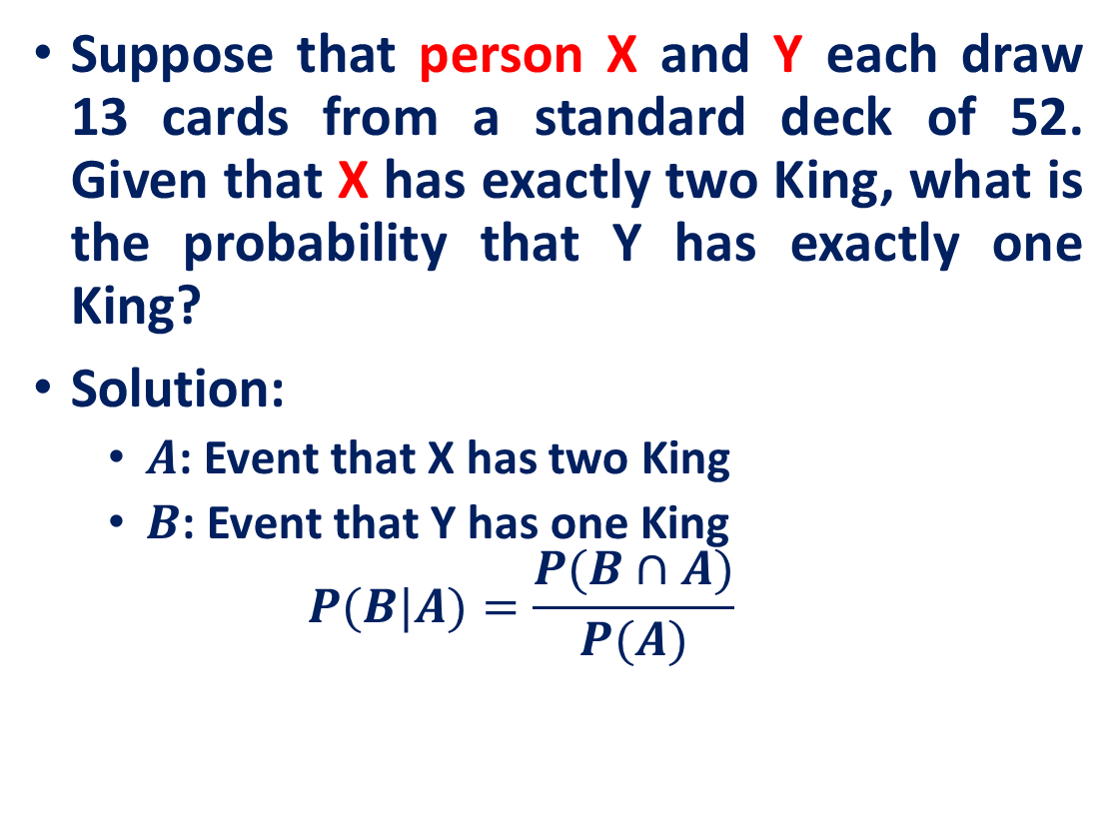
Conditional Probability
Suppose that person X and Y each draw 13 cards from a standard deck of 52. Given that X has exactly two King, what is the probability that Y has exactly one King?
Solution:
$A$: Event that X has two King
$B$: Event that Y has one King
$$P(B|A)=\frac{P(B∩A)}{P(A)}$$
$$P(A)=\frac{\left(\begin{matrix}4 \\ 2\end{matrix}\right)\left(\begin{matrix}48 \\ 11\end{matrix}\right)}{\left(\begin{matrix}52 \\ 13\end{matrix}\right)}$$
$$P\left(B∩A\right)=\frac{\left(\begin{matrix}4 \\ 2\end{matrix}\right)\left(\begin{matrix}48 \\ 11\end{matrix}\right)\left(\begin{matrix}2 \\ 1\end{matrix}\right)\left(\begin{matrix}37 \\ 12\end{matrix}\right)}{\left(\begin{matrix}52 \\ 13\end{matrix}\right)\left(\begin{matrix}39 \\ 13\end{matrix}\right)}$$
$$P(B|A)=\frac{\frac{\left(\begin{matrix}4 \\ 2\end{matrix}\right)\left(\begin{matrix}48 \\ 11\end{matrix}\right)\left(\begin{matrix}2 \\ 1\end{matrix}\right)\left(\begin{matrix}37 \\ 12\end{matrix}\right)}{\left(\begin{matrix}52 \\ 13\end{matrix}\right)\left(\begin{matrix}39 \\ 13\end{matrix}\right)}}{\frac{\left(\begin{matrix}4 \\ 2\end{matrix}\right)\left(\begin{matrix}48 \\ 11\end{matrix}\right)}{\left(\begin{matrix}52 \\ 13\end{matrix}\right)}}$$

Slide 23

Conditional Probability
$P(A | B)=\frac{P\left(A ∩ B\right)}{P\left(B\right)}$ then
$P\left(A ∩ B\right)=P(A | B)P\left(B\right)$
If $E_{1},…, E_{n}$are events then
$$P\left(E_{1}∩E_{2}∩…∩E_{n}\right)=P\left(E_{1}\right)P\left(E_{2} | E_{1}\right)P\left(E_{3} | E_{1}∩E_{2}\right),…,P(E_{n}|E_{1}∩E_{2}∩…∩E_{n−1})$$

Slide 24
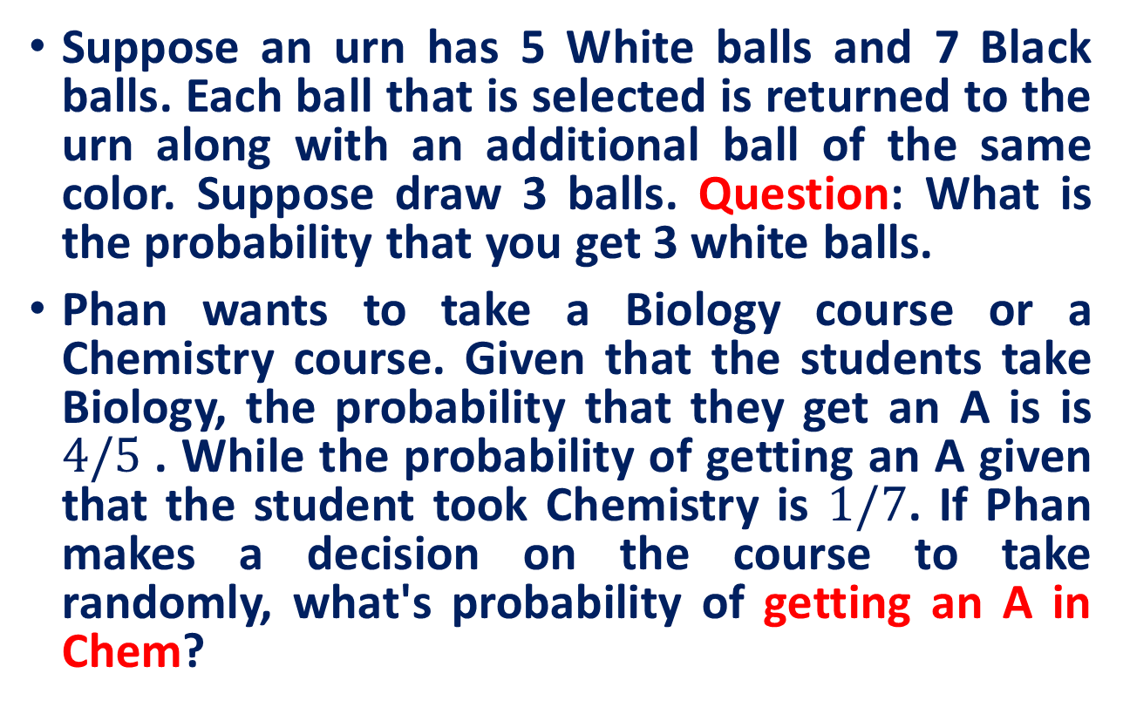
Practice Exercises
Suppose an urn has 5 White balls and 7 Black balls. Each ball that is selected is returned to the urn along with an additional ball of the same color. Suppose draw 3 balls. Question: What is the probability that you get 3 white balls.
Phan wants to take a Biology course or a Chemistry course. Given that the students take Biology, the probability that they get an A is is $4/5$. While the probability of getting an A given that the student took Chemistry is $1/7$. If Phan makes a decision on the course to take randomly, what's probability of getting an A in Chem?

Slide 25
Next Class
Bayes's Formula

Slide 26
Reference
Statistics with Economics and Business Applications, Chapter 3 Probability and Discrete Probability Distributions
Modern Business Statistics, Slides by John Loucks
lecture notes on Probability Theory by Phanuel Mariano

